Slide 1

Variables, Data Types and Basic Operations
Alp KUT
Derya BİRANT
Kökten Ulaş BİRANT

Slide 2
OUTLINE
Variables
Assignment Statements
Data Types
Input / Output Statements
Comments
Arithmetic Operators
Mathematical Functions
Examples

Slide 3
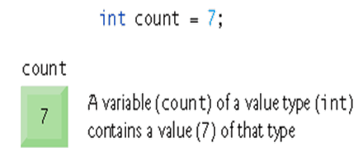
Variables
A variable denotes a data object to be used in a computation
Every variable has a name, a type, a size and a value

Slide 4
Variable Names
Variable names can consists of
  Letters (a-z, A-Z)
  Digits (0-9)
  Underscore (_)
Example: Number1, Number2, First_Number, Sum, ...
Don’t use Turkish characters (ö,ü,ğ,ç,ş,ı) in variable names.
Case sensitive (sum and Sum are different variables)

Slide 5
Variables
Which components are variables in the following flowchart?
Start
Read (A)
Read (B)
A, B, C, Average
Read (C)
Average = (A + B + C) / 3
Write Average
End

Slide 6
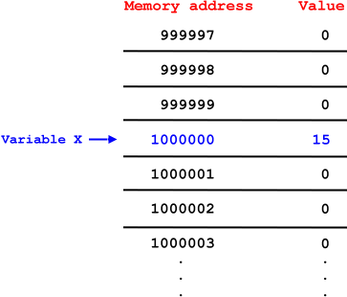
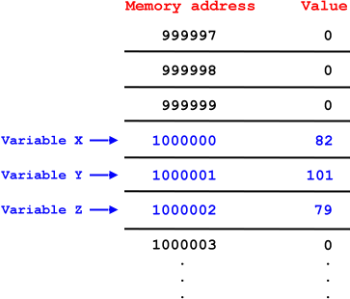
Variables
Each variable name corresponds to location in memory
int x;
int y;
int z;
x = 15;
x = 82;
y = 101;
z = 79;
int x;
x = 15;

Slide 7
Assignment Statements
When new value is placed into a variable, replaces previous value
A = 5
B = 10
C = A + B
A
B
C
?
?
?
5
?
?
5
10
?
5
10
15

Slide 8
Assignment Statements
Moving a variable value to another variable
A = 3
B = 4
A = B
A
B
?
?
3
?
3
4
4
4

Slide 9
Assignment Statements
Moving a variable value to another variable
A = 3
B = 4
A = A + B
A
B
?
?
3
?
3
4
7
4

Slide 10
Variable Definition in C#
int i = 123;
  double pi = 3.14;
  char ch = ‘A’;
  string s = “I am a string”;
  bool flag = true;
i
123
pi
3.14
ch
A
s
I am a string
flag
true

Slide 11
Data Types
C# | Signed | Memory | Range
Sbyte | Yes | 1 byte | –128 ... 127
Short (Int16) | Yes | 2 bytes | –32.768 ... 32.767
Int (Int32) | Yes | 4 bytes | –2.147.483.648 ... 2.147.483.647
Long (Int64) | Yes | 8 bytes | –9.223.372.036.854.775.808 .. 9.223.372.036.854.775.807
Byte | No | 1 byte | 0 ... 255
Ushort | No | 2 bytes | 0 ... 65535
Uint | No | 4 bytes | 0 ... 4294967295
Ulong | No | 8 bytes | 0 ... 18.446.744.073.709.551.615
Float | Yes | 4 bytes | -3.402823e38 .. 3.402823e38
Double | Yes | 8 bytes | -1.79769313486232e308 .. 1.79769313486232e308
Decimal | Yes | 12 bytes | -79228162514264337593543950335 .. 79228162514264337593543950335
Char |  | 2 bytes | Unicode characters
boolean |  | 1 byte | True or false

Slide 12
Assignment Statement in C#
Variable values can be changed by using “=“ operator
Assing from right to left
int A;
int B;
int C;
A = 5;
B = 10;
C = A + B;
A
B
C
?
?
?
5
?
?
5
10
?
5
10
15

Slide 13
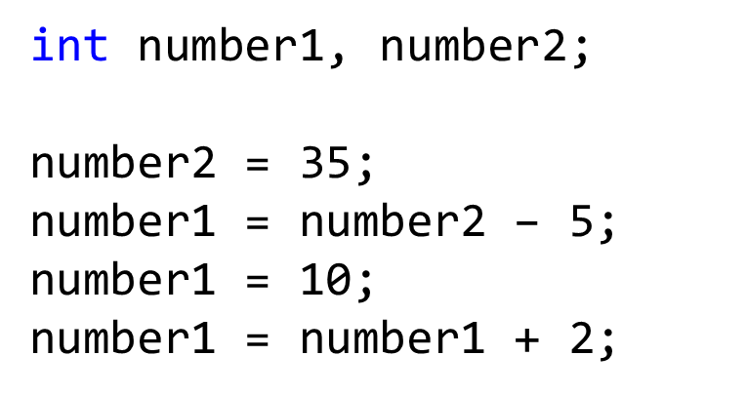
Question
What is the final value of the variable "number1"?

Slide 14
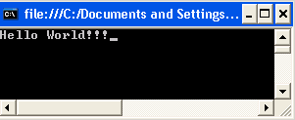
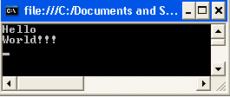
Output Statements
Console.Write: Writes the current line as an output and cursor stays at the same line.
Console.WriteLine: Writes the current line as an output and moves the cursor to the next line.
Console.Write("Hello ");
Console.Write("World!!!");
Console.WriteLine("Hello ");
Console.WriteLine("World!!!");

Slide 15
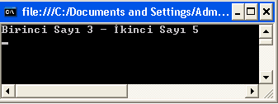
Output Statements
To print the value of the variables, use "+" symbol
int A;
int B;
A = 3;
B = 5;
Console.WriteLine("Birinci Sayı " + A + " - İkinci Sayı " + B);

Slide 16
Question
Write the values of the variables on the screen as follows:
  int age = 20;
  string name = "derya";
  int sister_number = 2;
  My name is derya, I have 2 sisters and I am 20 years old.

Slide 17
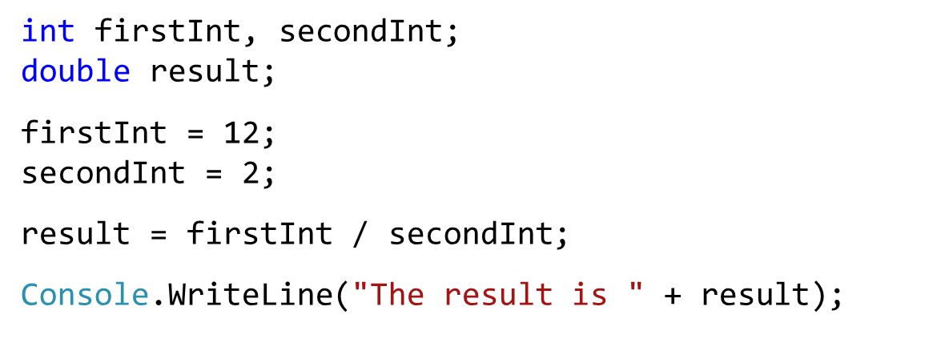
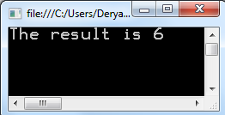
Question
What is the output of the following program?

Slide 18
Input Statements
Console.ReadLine: Reads the next line of characters as a string from the user.
Example:
name
?
string name;
Console.Write("Please enter your name:");
name = Console.ReadLine();
derya

Slide 19
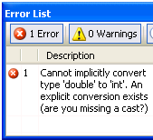
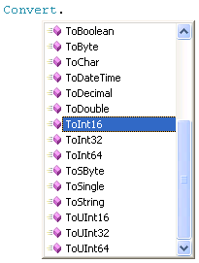
Convert Method
It is used for converting data from one type to other.
int number;
double price;
bool flag;
char ch;
number = Convert.ToInt16(Console.ReadLine());
price = Convert.ToDouble(Console.ReadLine());
flag = Convert.ToBoolean(Console.ReadLine());
ch = Convert.ToChar(Console.ReadLine());
Console.WriteLine("Sayı " + number + " Fiyat " + price +
" Mantıksal " + flag + " Karakter " + ch);

Slide 20
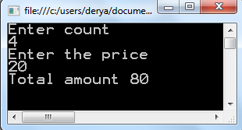
Example
int count;
double price;
Console.WriteLine("Enter count");
count = Convert.ToInt16(Console.ReadLine());
Console.WriteLine("Enter the price");
price = Convert.ToDouble(Console.ReadLine());
Console.WriteLine("Total amount " + (count * price));

Slide 21
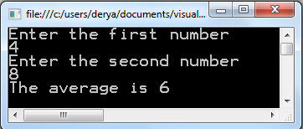
Question
Read two numbers from the user and print the average of them.

Slide 22
Comments
Comments ignored during program execution
  Describes code and provides code readability
  Single line command //
  Multiple line command /* .... */
  // Comment a single line
  /* Comment
  multiple
  lines
  */

Slide 23
Aritmetic Operators
Operation | Arithmetic operator
Addition | +
Subtraction | –
Multiplication | *
Division | /
Remainder | %
double number1 = 5;
double number2 = 2;
Console.WriteLine("Sum " + (number1 + number2));
Console.WriteLine("Subtraction " + (number1 - number2));
Console.WriteLine("Multiplication " + (number1 * number2));
Console.WriteLine("Division " + (number1 / number2));
Console.WriteLine("Mod operation " + (number1 % number2));

Slide 24
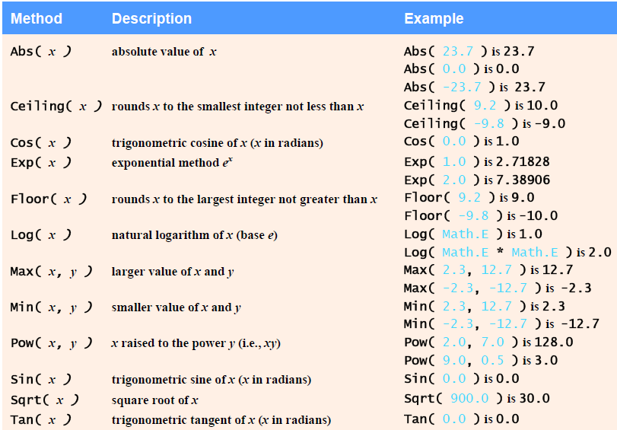
Mathematical Functions

Slide 25
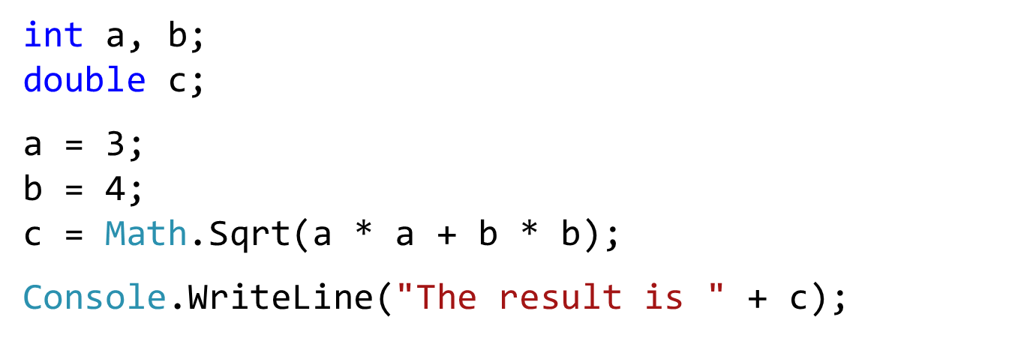
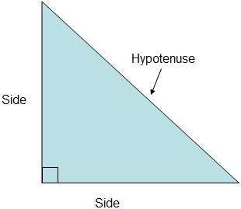
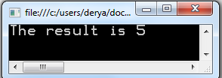
Example (Mathematical Functions)

Slide 26
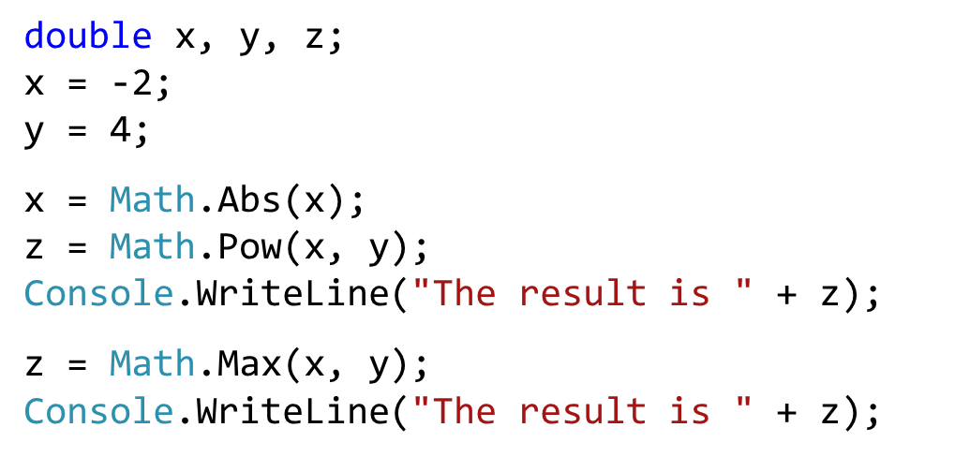
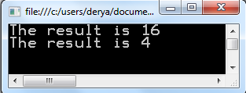
Question
What is the output of the following program?

Slide 27
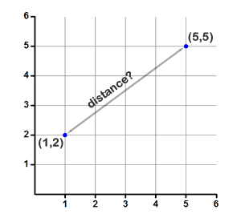
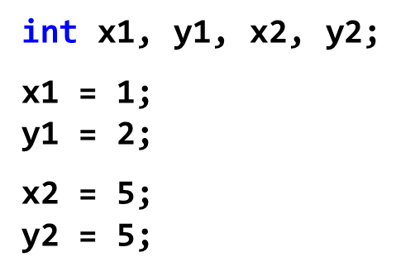

Question
Write a program that finds the distance between two points (x1, y1) and (x2, y2).

Slide 28
Random Number
Generating a number between 1 and 6 randomly.
Random random = new Random();
int number;
number = random.Next(1, 7);
Console.WriteLine(number);

Slide 29
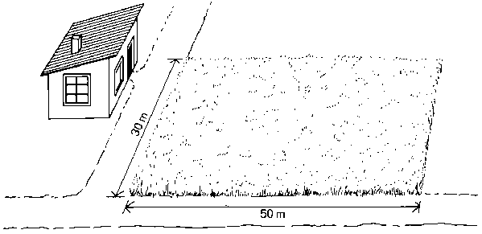
Example 1
Finding the area of a field
Start
int width, length, area;
Console.Write("Enter the width of field: ");
width = Convert.ToInt32(Console.ReadLine());
Console.Write("Enter the length of field: ");
length = Convert.ToInt32(Console.ReadLine());
area = width * length;
Console.WriteLine("The area of the field " + area);
Console.ReadLine();
Read (width)
Read (length)
area = width * length
Write Area
Stop
length
width

Slide 30
Algorithm vs. Program
Algorithm (in textual and graphical)
Start
Algorithm FieldArea
Input: The width and length of the field.
Output: The area of the field.
Read width, length
area = width * length
Write Area
End Algorithm
Read (width)
Read (length)
area = width * length
Write Area
Program
Stop
int width, length, area;
Console.Write("Enter the width of field: ");
width = Convert.ToInt32(Console.ReadLine());
Console.Write("Enter the length of field: ");
length = Convert.ToInt32(Console.ReadLine());
area = width * length;
Console.WriteLine("The area of the field " + area);
Console.ReadLine();

Slide 31
Question
Write C# code of the following algorithm.
Start
Read (A)
Read (B)
Read (C)
Average = (A + B + C) / 3
Write Average
End

Slide 32
Example 2
Write a program that converts the temperature value given in Centigrade (°C) degree to Fahrenheit (°F)
F = 9/5C +32
double centi;
double fahri;
Console.WriteLine("Please enter degree in C");
centi = Convert.ToDouble(Console.ReadLine());
fahri = 9.0 / 5.0 * centi + 32.0;
Console.WriteLine("Result degree in F " + fahri);

Slide 33
Example 3
Take the grades of the student and then calculate her/his course grade.
%25 MidtermExam %25 Assignment %50 FinalExam
double midtermexam, assignment, finalexam, grade;
Console.WriteLine("Please enter midterm exam grade:");
midtermexam = Convert.ToDouble(Console.ReadLine());
Console.WriteLine("Please enter assignment grade:");
assignment = Convert.ToDouble(Console.ReadLine());
Console.WriteLine("Please enter final exam grade:");
finalexam = Convert.ToDouble(Console.ReadLine());
grade = midtermexam * 0.25 + assignment * 0.25 + finalexam * 0.5;
Console.WriteLine("Grade = " + grade);

Slide 34

Question
Write a program that computes the area of the red doughnut?
Example:
Inputs: R1 = 6 R2 = 2
Output: 100.48

Slide 35
Solution
int radius1, radius2;
double area;
Console.Write("Enter the radius of big circle: ");
radius1 = Convert.ToInt32(Console.ReadLine());
Console.Write("Enter the radius of small circle: ");
radius2 = Convert.ToInt32(Console.ReadLine());
area = (3.14 * radius1 * radius1) - (3.14 * radius2 * radius2);
Console.WriteLine("Result = " + area);

